Slide 1
Target-Sensitive Memory Networks for Aspect Sentiment Classification
Shuai Wang, Sahisnu Mazumder, Bing Liu, Mianwei Zhou, Yi Chang
Department of Computer Science, University of Illinois at Chicago, USA
ACL 2018

Slide 2
1 Aspect Sentiment Classification(ASC)
(1) The screen resolution is excellent but the price is ridiculous.
(2) The screen resolution is excellent but the price is high.
(3) The price is high.
(4) The screen resolution is high.

Slide 3
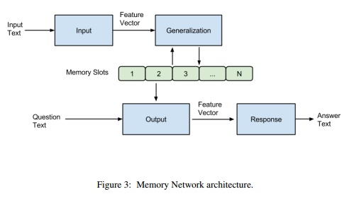
2 Memory Network for ASC
MEMORY NETWORKS 2014 Facebook AI Research
QA, long-term memory component, m and I, G, R, O

Slide 4
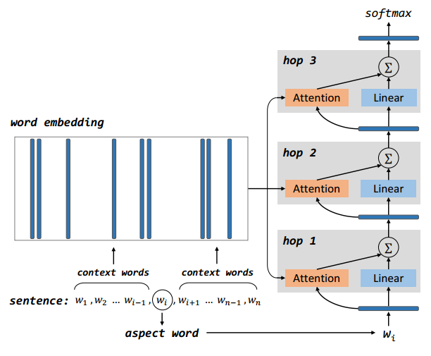
2 Memory Network for ASC
(2) Aspect Level Sentiment Classification with
Deep Memory Network
EMNLP 2016, Duyu Tang , Harbin Institute of Technology

Slide 5






3 Challenge
Input: target aspect t ,
context word x_{i},
Attention:
Output Representation :
Sentiment Score :

Slide 6
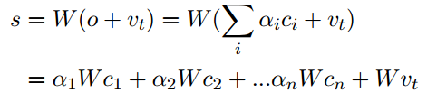






3 Challenge
(1)an aspect word often expresses no sentiment, for example, “screen”. it causes the problem that the model cannot handle target-dependent sentiment.
(2) If an aspect word is considered and it directly bears some positive or negative sentiment.
two target words price and resolution (denoted as p and r)
two possible context words “high” and “low” (denoted as h and l)
(b) (d)

Slide 7

4 Approaches
Non-linear Projection (NP)
Cons: sacrifice some interpretability : c_{i} affect s

Slide 8


4 Approaches
Contextual Non-linear Projection (CNP):
Pros: can be viewed as the target-aware context representation of context. Cons: uses the same set of vector representations (learned by embeddings C) for multiple purposes.

Slide 9


4 Approaches
Interaction Term (IT):
Pros: formulate explicit target-context sentiment (TCS) interaction terms. the sentiment effect is explicitly dependent on its target and context.

Slide 10

4 Approaches
Coupled Interaction (CI) :

Slide 11

4 Approaches
Joint Coupled Interaction (JCI):
Pros: reduce the number of learning parameters and simplify the CI model.

Slide 12
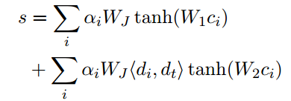
4 Approaches
Joint Projected Interaction (JPI):
a context output vector c_{i} will be projected to two different continuous spaces before sentiment score calculation.

Slide 13
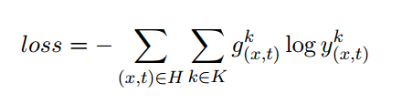
4 Approaches
Loss Function:

Slide 14
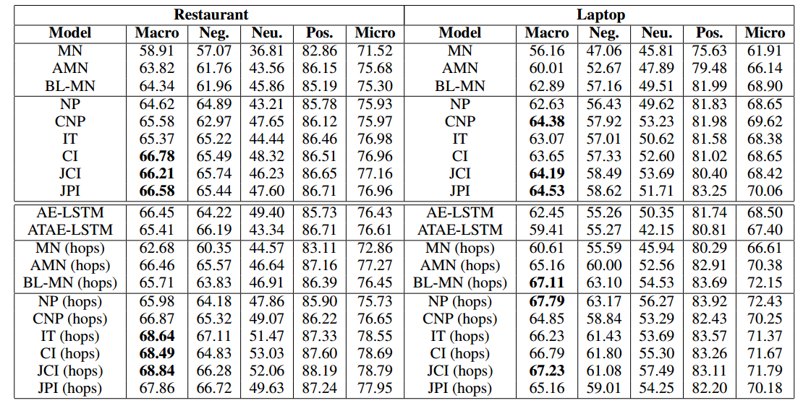
4 Experiment

Slide 15
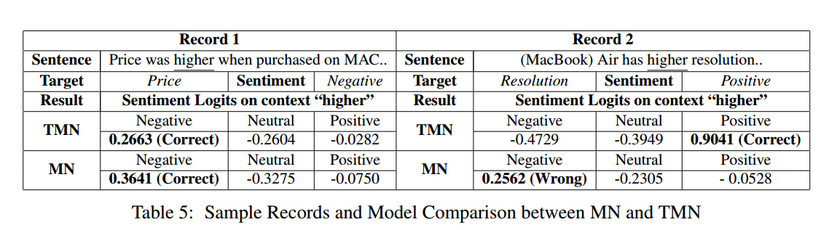
4 Experiment

